Slide 1
COMP814 Deep Learning II Transformers/Transfer Learning

Slide 2
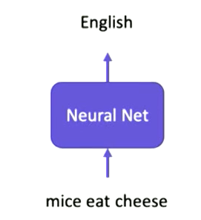
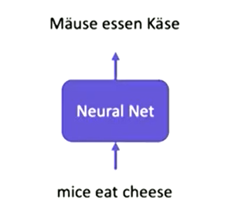
Seq -> Seq (review)

Slide 3
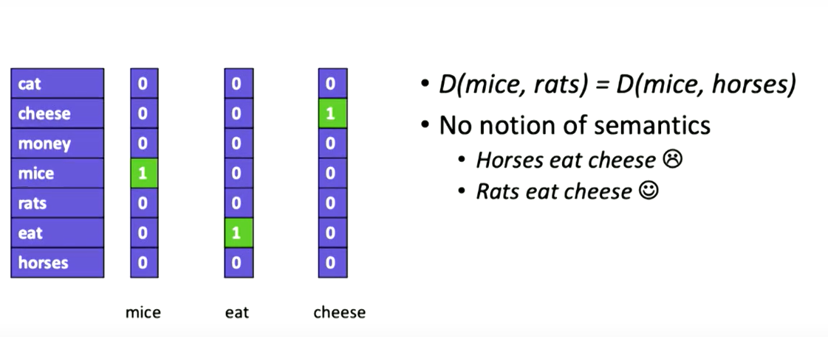
How do we represent words (review)
One hot representation
No semantic representation

Slide 4
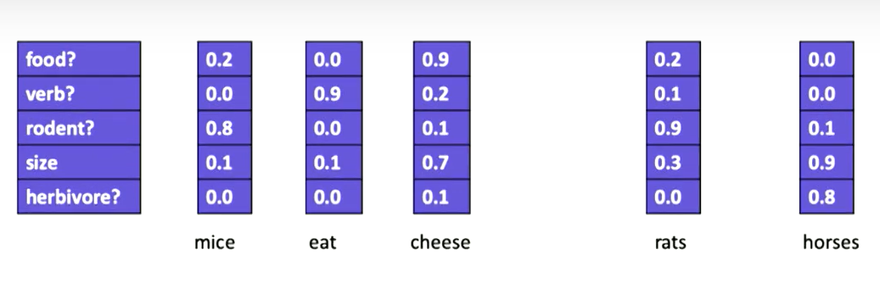
Word Embedding (review)
Enables Semantics
Enables us to compute distance between words
Similarity
E.g. Euclidian distance, Cosine distance (dot product)

Slide 5
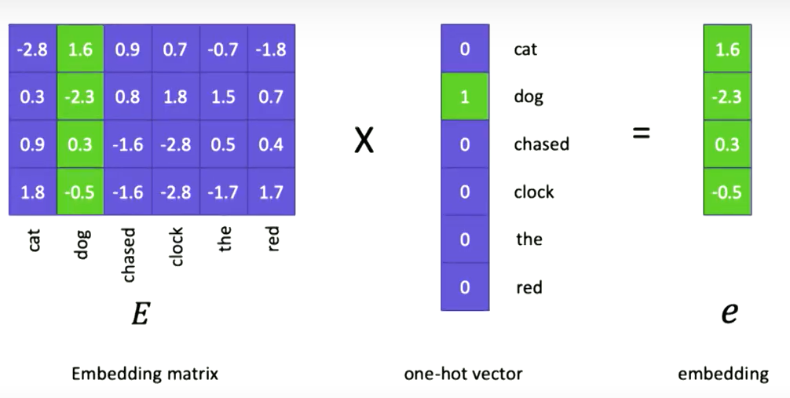
Extracting the embedded vector from one hot representation. (review)

Slide 6
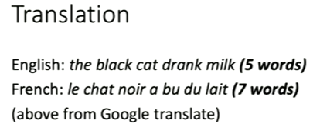
Language Translation

Slide 7
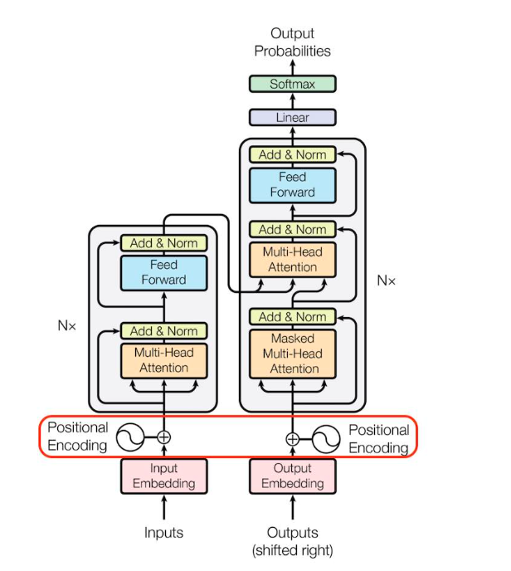
Encoder/Decoder (Transformer)
From the paper “Attention is all you need”
By Vaswani et al 2017

Slide 8
Language Translation
Many to Many
But we need a fixed size vector for NN
So can compare them
Use as input and to represent as hidden states
Need a conditional language model where the output is conditioned on the input, not just the previous word in the output.

Slide 9
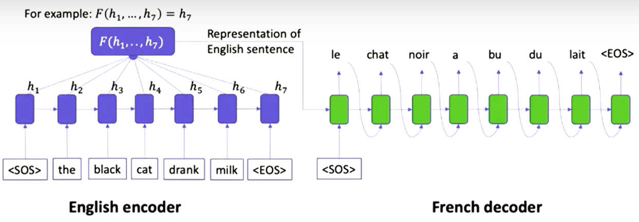
Could represent the English sentence by the final vector h₇
Training – using parallel corpus with English -> French sentences
Predict one word at a time.
End to end training
Teacher forcing – uses ground truth at each time stamp instead of machine output.
Masked head – masking the forward words.

Slide 10
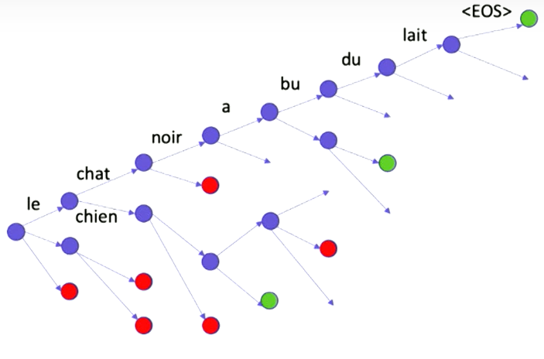


Encoder Decoder during testing
Goal: to predict the next word
Conditioned on:
The whole of the source sentence.
The predicted words so far in the target sentence.
Greedy:
“le chat…” or
Le chien…”
Beam search:
Keep n best hypothesis
Add all <EOS> hypotheses to the candidate list
Stop when enough hypotheses found
Normalise the score by its length

Slide 11
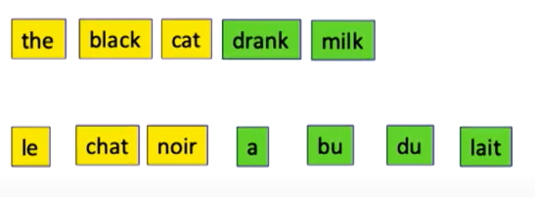
Encoder/decoder model so far
The decoder depends on the same encoder hidden state for predicting all of the target words.
Turns out that this is not true when we translate as humans
We focus on few words when translating a part of the source sentence.

Slide 12
RNN problems
Suffers from long range dependencies.
Not good for long sequences
Suffers from vanishing gradient and gradient explosion due to the depth of network
All the computations occurs sequentially so can not exploit GPU parallelisation.

Slide 13
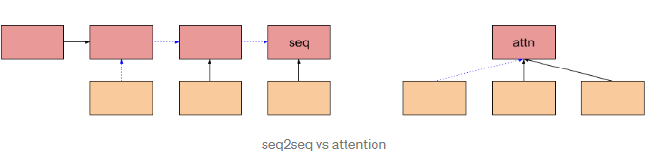
Solution: Attention
A mechanism to focus on only some words in the source sentence at a time step.
The degree of focus on each word is represented by a scaler for each word summing up to 1.
Highly parallelizable
So can take advantage of GPUs
Allows expression of focus on words in a sequence at once rather than in a sequence

Slide 14
Self Attention

Slide 15
Self Attention…

Slide 16
Self Attention…
No trainable weights
Order has no influence
Proximity has no influence
Shape independent

Slide 17
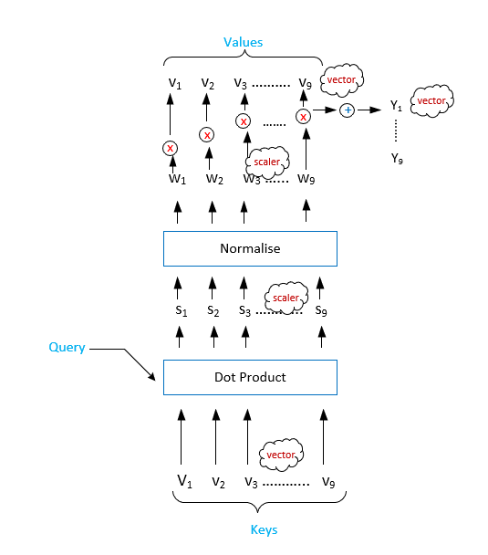
Query, Key, Value
Nothing trainable
Introduce Query, Key, Value
Key – vector representation of the sequence
Query – the word for which context to be computed
Value – Query vector multiplied to the sequence – gives adjusted weights (attention) for each of the other words

Slide 18
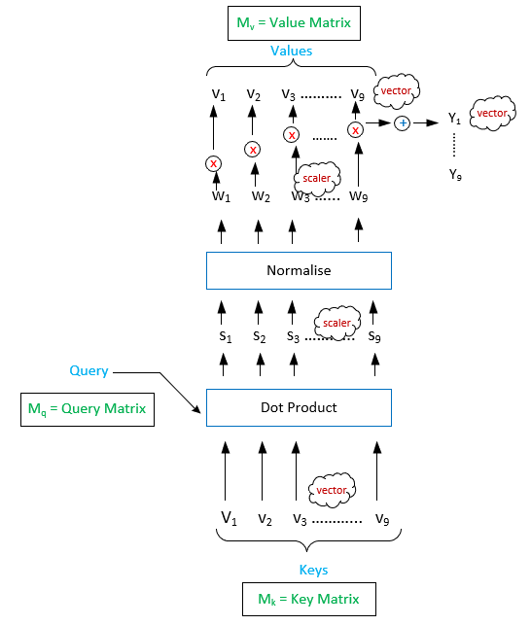
Make it train-able
If v is 1 x k
Multiply vector v by k x k matrix
Initialised with random no.s
Result is 1 x k
M_{k}, M_{q} and M_{v} - are trainable matrices
Weights updated as part of training process.

Slide 19
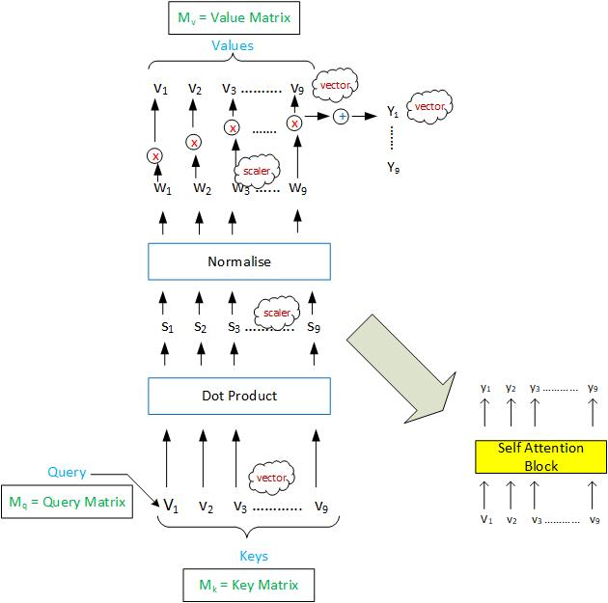
Attention Block
Can we improve this?

Slide 20
Multi head attention

Slide 21
Multi head attention intuition
Uses same KQV but with different initial matrices.
Projects the input embeddings into different subspaces representing different aspects.
Expands the models ability to focus on different positions, such as co-refs, subject, gender etc.
Attention is all you need uses 8 heads.

Slide 22
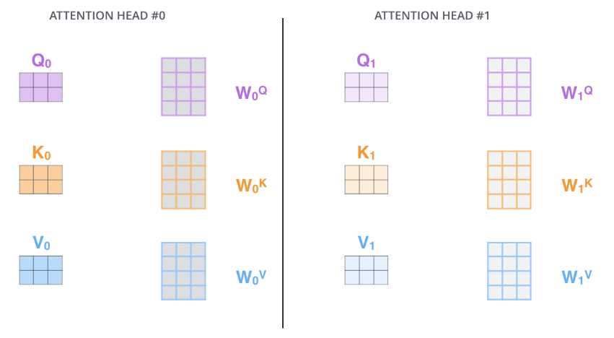
Multi head attention

Slide 23
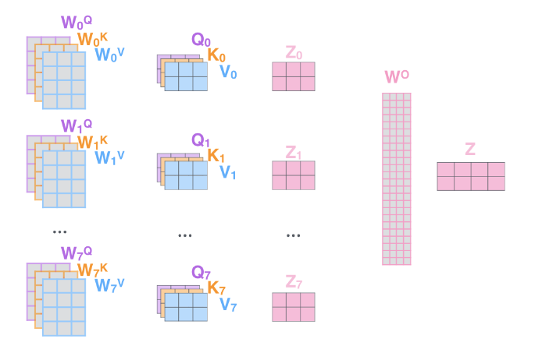
Multi head attention

Slide 24
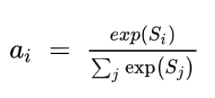
Normalisation
Done to scale down the weight numbers between 0 and 1.
Similarity – can be computed in different ways.
Dot product and then softmaxed
Scaled dot product (the score is divided by the dimensionality of the embedding vector and then softmaxed.
Can use Kernal Methods – mapping the 2 vectors (Q and K) into another space using non linear transformation (using a layer of neuron for example.
Softmax function

Slide 25
Including the token positions
Can do it in different ways as long as :
The positional information can be encoded into the embedding vector
The positional vector does not distort the final embedding vector
Transformer paper uses sine and cos functions for even and odd positions.

Slide 26
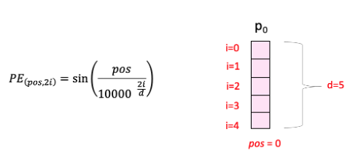
Positional info integration
pos is the position of the word in the sequence.
i is the frequency of the wave.

Slide 27
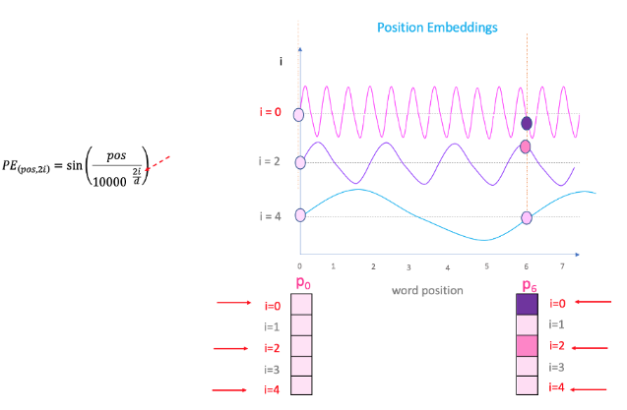
Use of wavelengths to embed.
The position is taken to be the height on the wave.
To avoid same height over a distance, we use different wavelengths.
The output value is added to the embedding vector to get the final embedding vector for each of the words with position awareness.
Illustration using modelling.

Slide 28
Decoder
Second part of Transformer architecture
Same mechanism as encoder but one word at time.
Many to many architecture
All words from encoder but only the previous words from the decoded sentence.
Training: all of the previous words
Teacher forcing.
Testing: Use previously generated word.

Slide 29
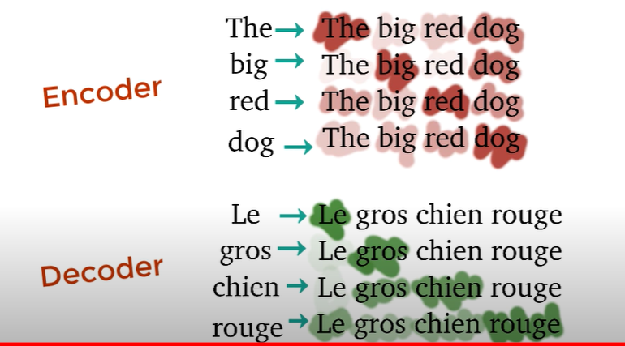
Decoder

Slide 30
Transformer –the whole thing

Slide 31
Transfer Learning
Most of the NLP (and other tasks) require common knowledge about language
Sentiment analysis
NER
Question answering
Machine translation
Reasoning
NLG
Etc.

Slide 32
Examples or pre-trained language models (open source)
BERT (Google) and variations such as RoBERta (Facebook)
CodeBERT (Microsoft)
GPT(-3) Open AI
ELMo (Allen AI)
ULMFit
XLNet
Huggingface Transformers: provides a pipeline of APIs for grouping together different pre-trained models for various NLP tasks.

Slide 33
Self Attention Visualisation Demo
Visualization
HuggingFace Demo

